Slide 1



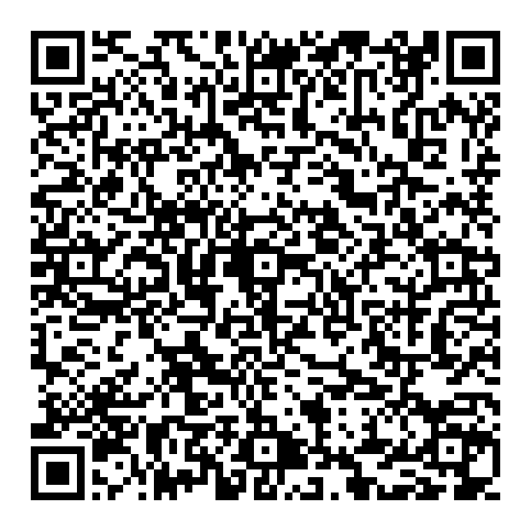
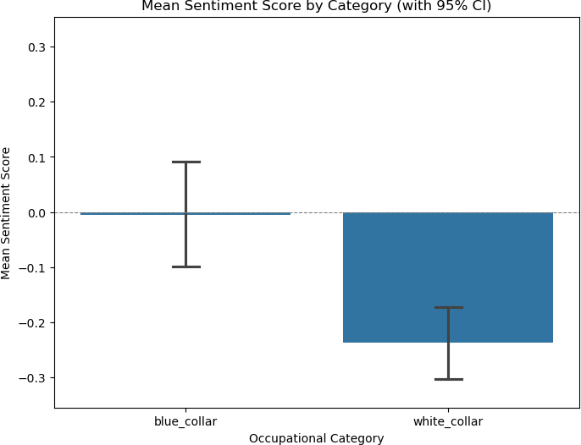
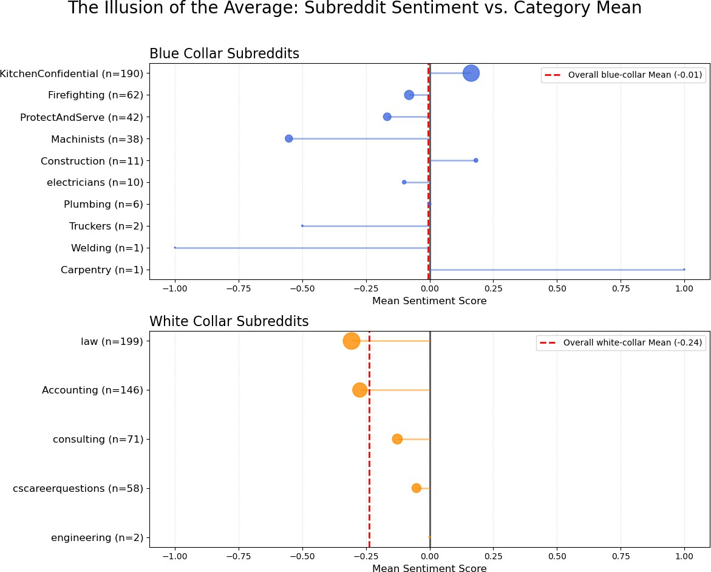



Who Was More Vaccine-Skeptical Online? A Computational Comparison of Occupational Groups on Reddit
Usmaan Shah, DO,^{1,3} Judith M Graber, PhD, MS^{2,3}, Julie Caruth, MD, MPH^{1,3}
¹Rutgers, The State University of New Jersey, School of Public Health, Environmental and Occupational Health and Justice Piscataway, New Jersey, USA
²Rutgers, The State University of New Jersey, Department of Biostatistics and Epidemiology, ³Rutgers, The State University of New Jersey, Environmental and Occupational Health Sciences Institute, Piscataway, New Jersey, USA
Residency Training Grant (Region II) Educational Resource Center Awarded by the CDC and NIOSH - Grant No. 5 T42 OH008422-10
Contact me!
Intro
  Public acceptance was key to the COVID-19 vaccine campaign
    Online platforms like Reddit became major arenas for shaping opinions
    Yet little is known about how vaccine sentiment varied by occupation
  Research Question
    How did COVID-19 vaccine sentiment differ by occupational groups on Reddit during 2021?
Methods
  Sampling:
    17 profession-specific subreddits were defined as blue collar or white collar
    Inclusion criteria included occupational focus and minimum subscriber count
  Sample Selection: items containing keywords: “vaccine,” “pfizer,” “moderna.”, “vaccine”, “vaccinated”, “vaccination”
Period: Jan 1–Dec 31, 2021
  Collection: PRAW (Python Reddit API Wrapper).
  Included items : 839 comments and posts
  Sentiment Gemini Flash 2.5 LLM used to analyze the item’s sentiment towards COVID vaccines
  Assigns sentiment score of:
      Positive; score = +1
      Negative; score = −1
      Neutral; score = 0
Representative examples
(r/KitchenConfidential, Positive):
    "If you're a chef and you give a single f*** [censored for profanity] about your craft, get the goddamn vaccine. Your food will be absolute s*** [censored for profanity] when you catch covid and can't smell or taste anything...“
(r/Construction, Positive):
    "It’s pretty hilarious a bunch of Construcrion guys are worried about the safety of the vaccine but meanwhile will walk steel, weld without ventilation, bitch about the silica rules and not wear their seatbelt...“
(r/Machinists, Negative):
    "developed very loud ringing after second Pfizer shot... Wouldn't have vaccinated if I knew it was going to do this. Its hell.“
(r/law, negative):
    "This will certainly end up in court. Will this Scotus hear it? Will it overturn Jacobson v. Mass. against vaccine mandates or will it overturn Wickard
    v. Filburn saying OSHA is outside the commerce clause?"
📂 Define Subreddits (17 blue/white-collar)
🔍 Collect Data via PRAW API (839 posts/comments, 2021)
🤖 Sentiment Analysis (Gemini LLM) (Classify as +1, 0, -1)
📊 Statistical Analysis
Conclusion
  Selected white collar communities on Reddit were more negative towards COVID-19 vaccination in 2021.
  Within group findings were more nuanced. Each occupational community expressed unique and specific viewpoints often driven by distinct workplace realities.
  Social media is a valuable tool
    Platforms like Reddit offer a real-time window into worker health concerns and can be considered as a viable public health surveillance tool
  Limitations
    Reddit users ≠ entire occupations
    Chosen keywords may bias sampling;
    Sentiment models can misclassify
    Cross-section: 2021 only; platform/sampling limit generalizability.

